Slide 1

The Analytics Team
Sprocket Central Pty Ltd
Data Analytics Approach
KPMG [junior analyst Team]

Slide 2
Agenda
Introduction
Data exploration
Model Development
Interpretation

Slide 3
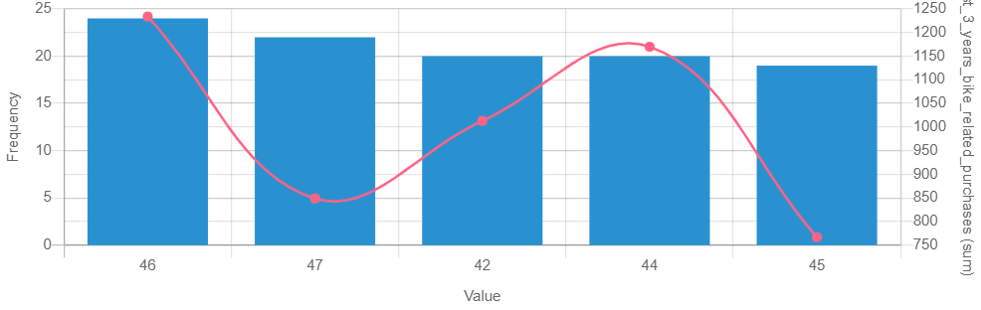
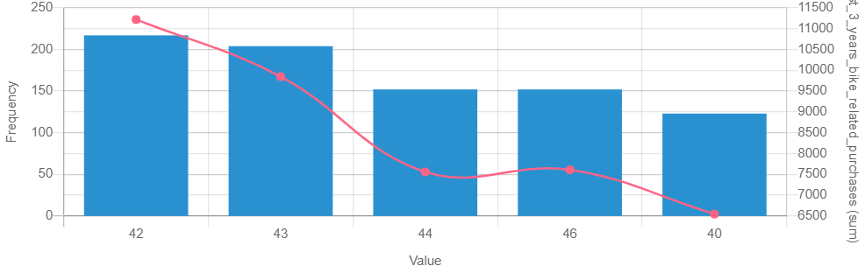
Data exploration
Customer Age Distribution
Mostly 40 - 47 age groups are frequent customers.
48 - 59 age group has big drop in percentage.
The red line shows the 3 years bike related purchase
Items
There is slightly increase in 59 to above age groups .
Percentage below 25 age not change. OLD
OLD
NEW

Slide 4
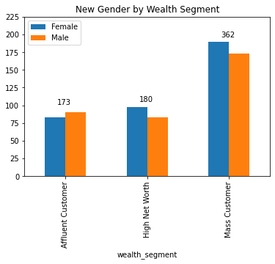
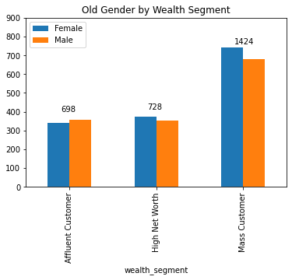
Wealth Segment (By gender)

Slide 5
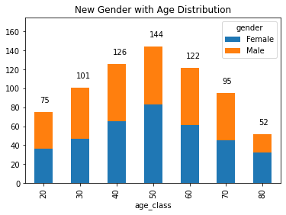
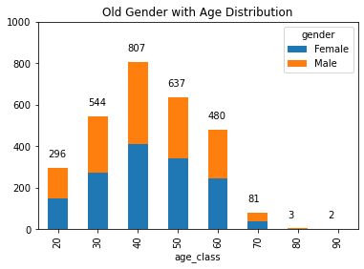
Gender Analysis
As per new customer data Female with 50.6% purchase with 25,212 bikes.
Male contributes to 47.7% purchase with 23,765 bikes.

Slide 6
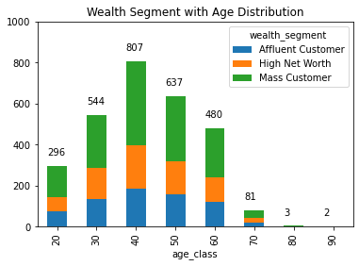
Welth Segmentation
Mass Customer is highest in all ages after that we focus on High Net Worth

Slide 7
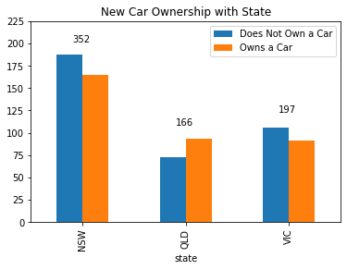
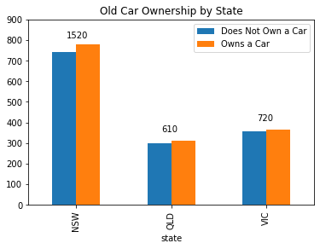
Car Ownership (By State)
NSW State has more potential customers .
As per new data owners visit less than who do not own car.

Slide 8
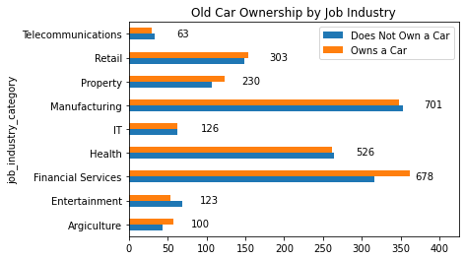
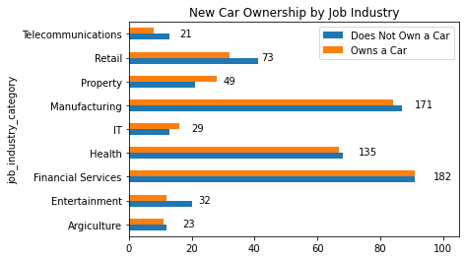
Car Ownership by Industry
As per new data most of customers are from Financial Services and Manufacturing industries.
Rank and Value columns are highly correlated (-0.98) .

Slide 9
Apendix
All support items in the attachment.

